Slide 1
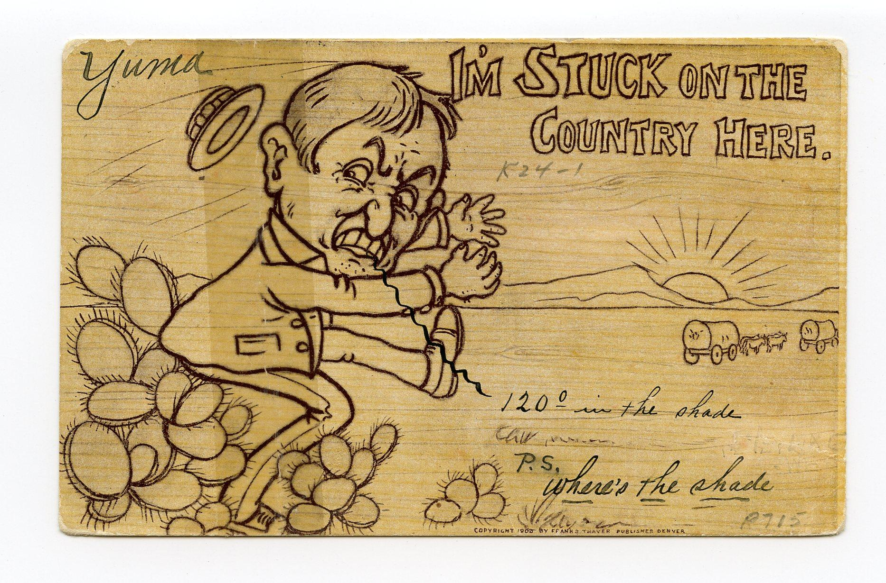
Arizona Historical Society 3rd Grade Postcard Contest
2024
Notes:
In 1863, President Lincoln signed a bill making the western half of New Mexico Territory a separate territory to be called “Arizona”. On February 14, 1912, we became a state. The Arizona Historical Society has the mission of connecting people to the history of Arizona.

Slide 2
Help the Arizona Historical Society celebrate Arizona’s Statehood!
Here at the Arizona Historical Society we are dedicated to education through our historic museums, field trips, tours, lessons and activities to help students understand how important Arizona history is to them.
Help us celebrate Arizona’s 112 birthday this year by participating in a Postcard Design Contest. This is offered to 3rd grade students only around the State of Arizona to let you show us what you have learned about Arizona in social studies and use your creativity to create a work of art.
Notes:
Can anyone tell me what they know about postcards? ACTIVITY: Create a list of what students know about postcards NOW. Then at the end of the powerpoint see what students can add to the list that they learned. Also there is a reading excerpt with more information about postcards and the role that they played in Arizona’s history. (There is also a reading excerpt about postcards that will give more information about the value of postcards during the time of statehood).

Slide 3
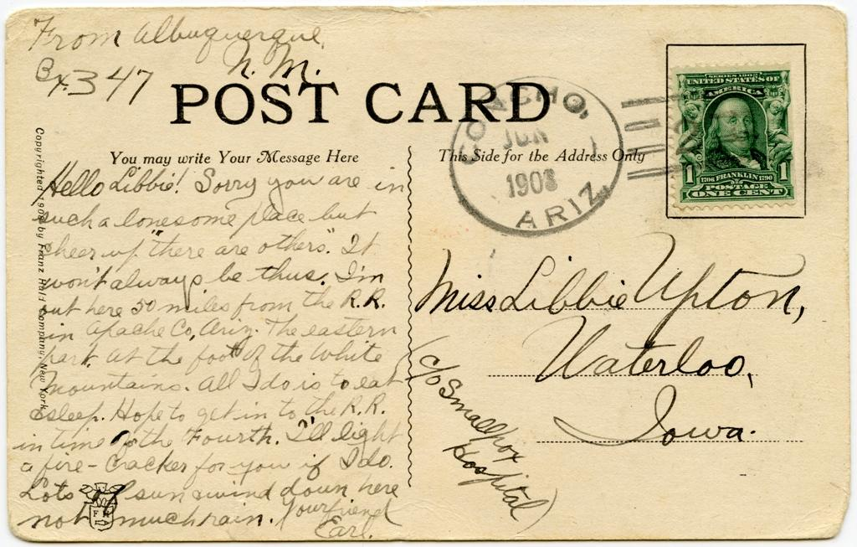
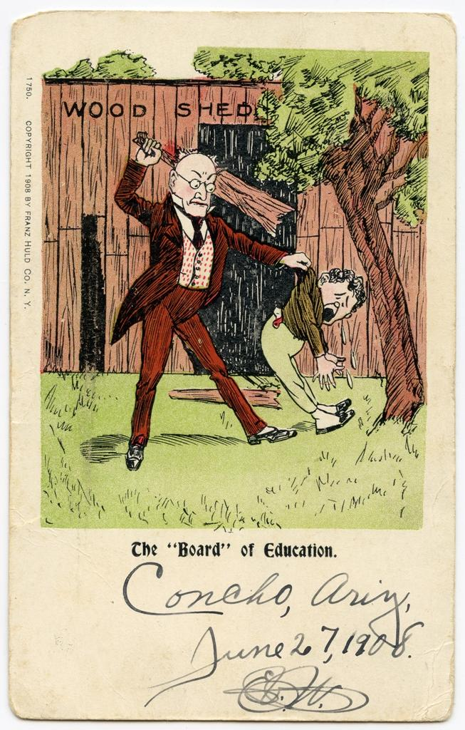
This is an old postcard. Front of card below. Back of postcard to the right. Be prepared to share what you notice.
Notes:
FRONT: Cartoon of teacher with a paddle and student. The “Board” of Education is a play on the word board in this cartoon. Board of Education is an elected group of people that are responsible for the education of children in their school districts AND Board represents a paddle in this postcard. In this time when the postcard was used, corporal punishment was legal in Arizona. Students could receive spankings if they broke classroom rules, were disrespectful to their teacher or other students.
Note the cursive writing of Concho, Ariz. June 27, 1908 handwritten on the postcard.
Ariz. is the old abbreviation of the postal abbreviation AZ that we now use when we address a letter.
BACK: Postcards had a small space to write a quick note and include the person you wanted to send the postcard to on the ride side.
Note the stamp used and cursive writing.

Slide 4
After looking at the postcard what did you notice?
As a group write down everything you noticed about the front of the postcard. Now what did you notice about the back of the postcard?
Postcards were very popular around the time that Arizona became a state. You will see various kinds of postcards with different types of fronts in this powerpoint. The backside of a postcard is where a person would write a short message (they would be the sender) and mail it to the person they wanted to get it delivered by a mailman in the mail (the recipient).
You will have opportunities to learn more about postcards. You are already learning about Arizona in your class and you will be creating a front to a postcard that you think represents Arizona. Your artwork can be anything that you feel says…THIS IS ARIZONA! It could be anything from prehistoric times to present day. It may show one of the many cultures here in Arizona or highlight one of the 22 Indian nations here in Arizona. Your postcard may represent one of the 5 Cs (Cotton, Cattle, Citrus, Climate or Copper). Be creative and show us what you know about Arizona!
Notes:
At this point do a review of any information you have covered with regard to Arizona.
Brainstorm Activity: Discuss what types of places, people, things, animals, plants are special to Arizona? Why are they special?

Slide 5
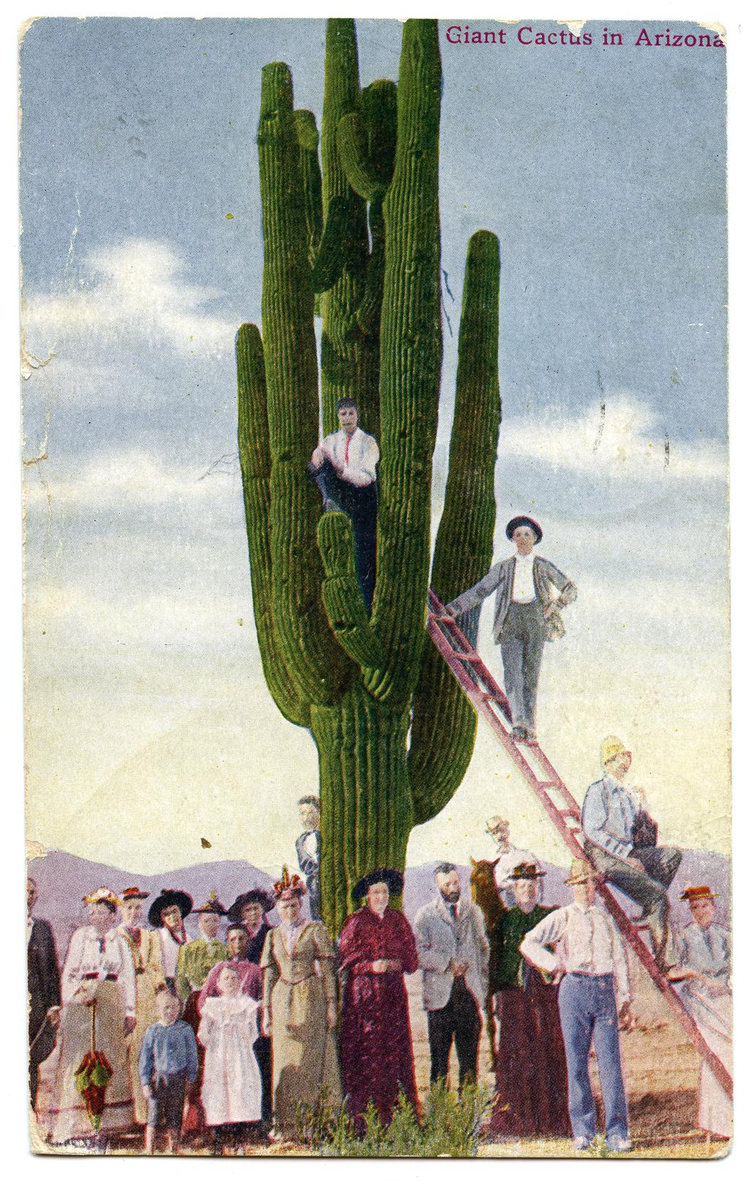
Your postcard may show Arizona’s state flag, bird, state fossil, state gemstone, state flower, state stamp, state mammal. It may showcase one of many amazing places here in Arizona like the Grand Canyon, Colorado River, or our state capitol. You may want to share the manys types of things you can do around here in Arizona.
You may want to focus on science topics in Arizona like water conservation, what types of foods grow here, or maybe a little bit about our climate.
We have many fun things to do here in Arizona, what could someone see or do if they came to visit Arizona?
Maybe you want to share some famous events or people from Arizona?
Notes:
(We have lessons on our website and also from the Stamp Discovery Education Program to use with your students to cover symbols of Arizona, things in Arizona and about stamps other great ways Arizona has been represented by the US Postal Service. These are a great resource for students to have information in one place that they may use to develop their piece of art.)

Slide 6
Lessons and Activities
On our website there are activities, lessons, and a reading assignment to help you develop a really good idea of what a postcard is, when it was invented, what did it do to help people communicate, and why postcards were important around the time that Arizona became a state.
The lessons and activities are designed to get you thinking about what your artwork will show people that may have never been to Arizona what it is like, what we can do, where we can go, what we see here in Arizona.
If your artwork is selected, you can win your class a PIZZA PARTY! You will also receive prizes and your artwork will be showcased as a postcard that will be sold at our museums! Look carefully at the next few slides. They are old postcards that were actually sent in the mail to people around the time that Arizona became a state. What type of stories about Arizona were they telling?

Slide 7
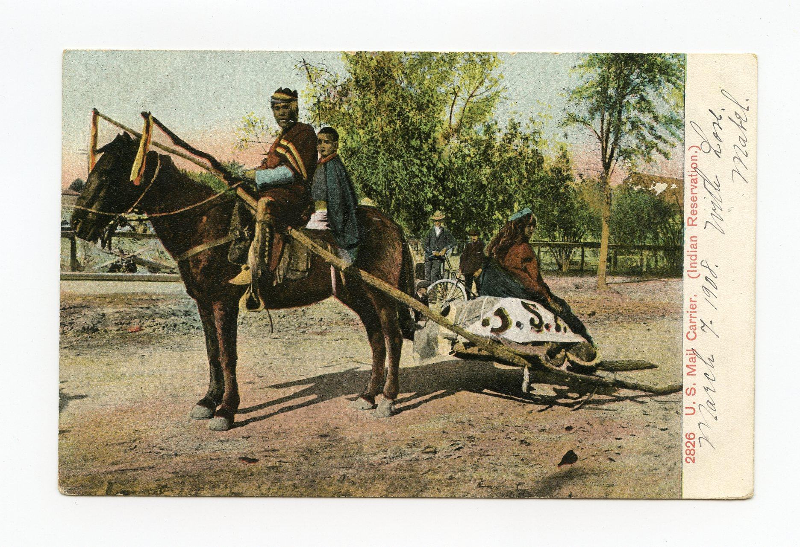
Sample Postcard
Notes:
This was a postcard sent tells a story. The story of how mail was delivered to families on the reservations here in Arizona.

Slide 8
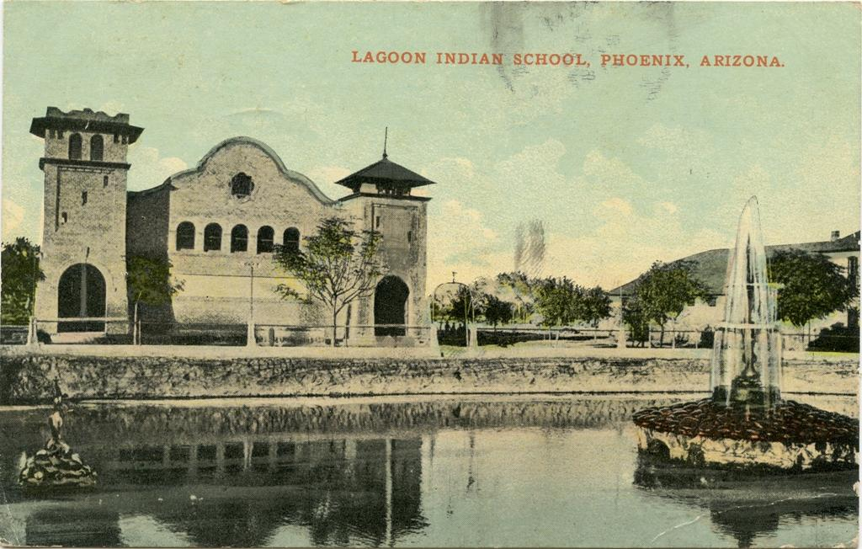
Sample Postcard
Notes:
This is an example of a school that was built in Phoenix for students that lived on the reservation. They were brought down and had to go to school here. Would you like to be taken from your home, have to live in a dormitory without family around just to be able to learn?

Slide 9
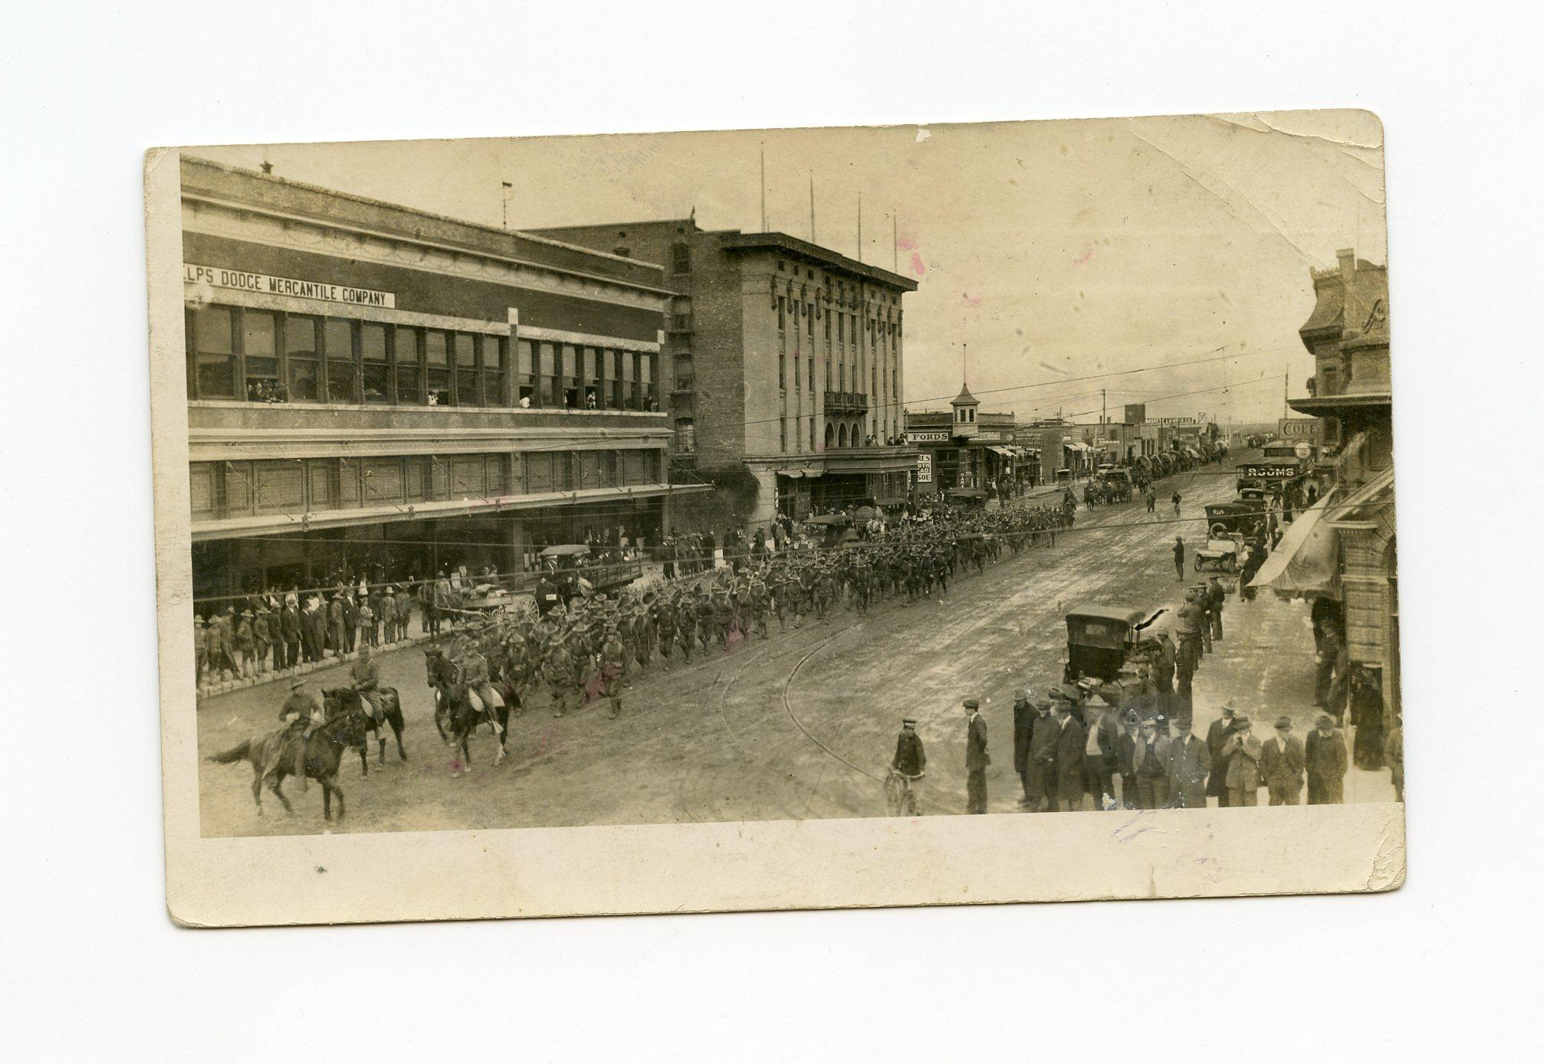
Sample Postcard
Notes:
Arizona became a state and is the sixth largest state in the country in terms of size. This postcard is a photo that was taken in Douglas, Arizona with the military marching through the streets.

Slide 10
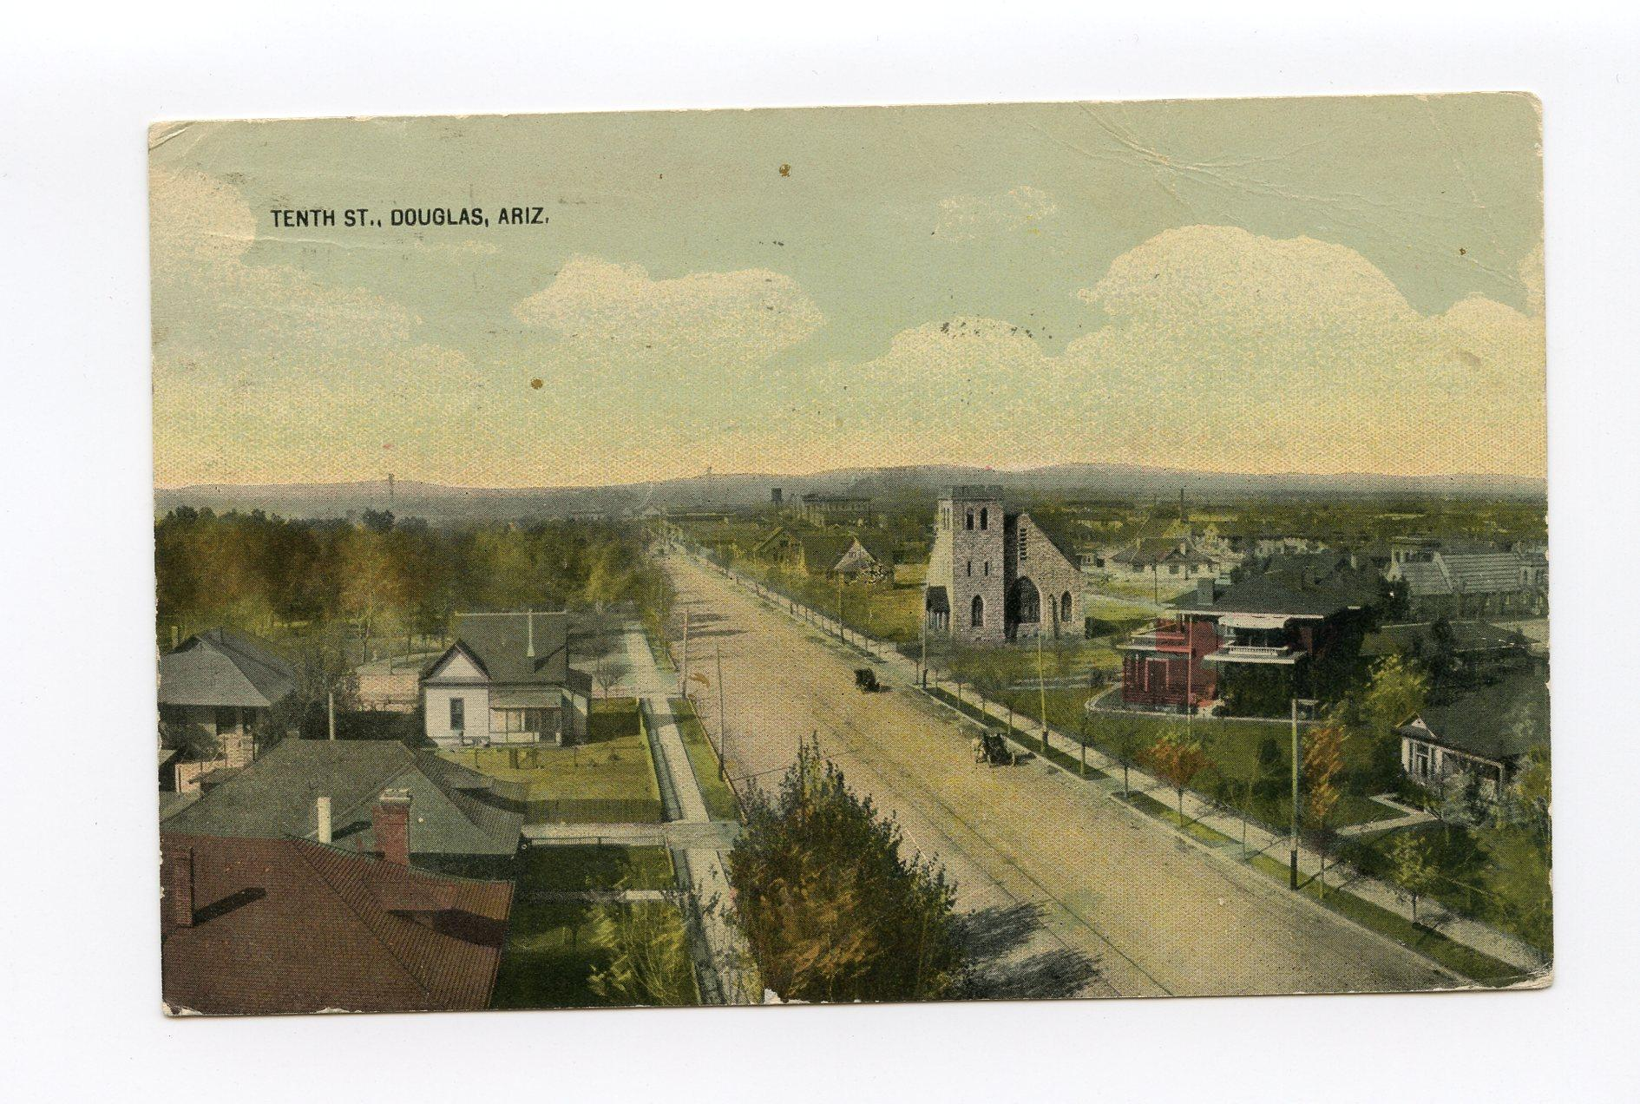
Sample Postcard
Notes:
This postcard was sender’s name was Gilmore. The recipient’s name was Cpl Taylor Bowen Company “H” 21st. Infantry Vancouver Barracks, Washington
The postcard message reads, Douglas, Arizona 11th Infantry July 28/15 Dear Bowen, Arrived here about a week ago and it is sure some place. I left a shield and can at the Post Hospital for you, Cpl Hamilton will give it to you. I’ll send postage so can forward those albums. You had better coem down here. GILMOUR

Slide 11
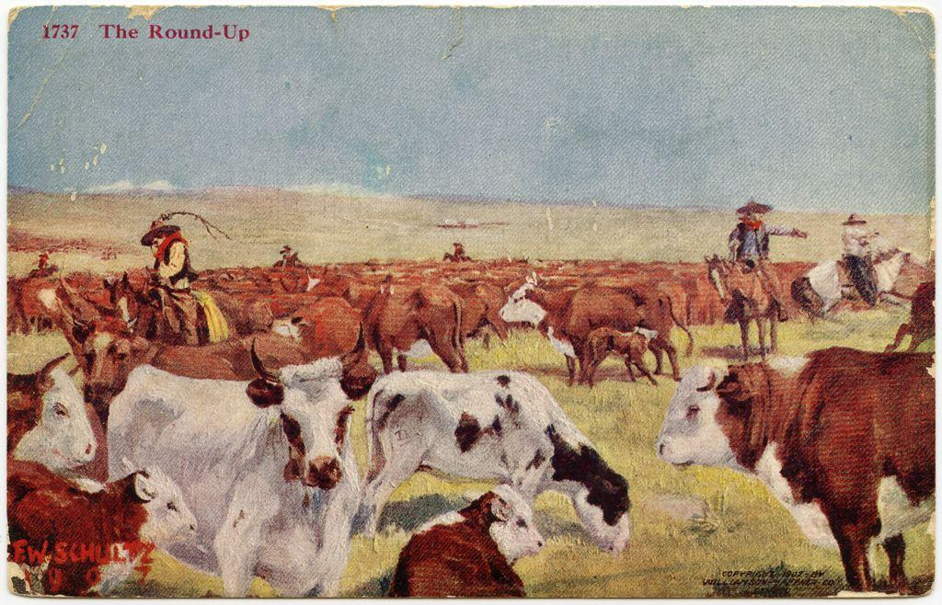
Sample Postcard
Notes:
This postcard showcases one of the 5Cs of Arizona, CATTLE. The 5Cs have been the driving force behind Arizona’s economy, and gave economic security to past generations and hope to many generations. Now Arizona has other things that help our economy. What type of things does Arizona have that helps support our economy? (2022 top economy sectors include: real estate, rental/leasing, manufacturing, healthcare and social assistance. Arizona continues to export agriculture and mining two of the original 5 Cs.
This was a postcard sent to Miss Anna Morrow in Ferguson, Kentucky. On the back of the postcard the letter reads, Navajo Ariz
11.17.1916 This will give you an idea of how we handle cattle on the range. We ride in the morning gather the cattle then each man goes in the herd and cuts his cattle out and are put in a bunch, so every five days each one takes his cattle home. Adios, Clarence.T

Slide 12
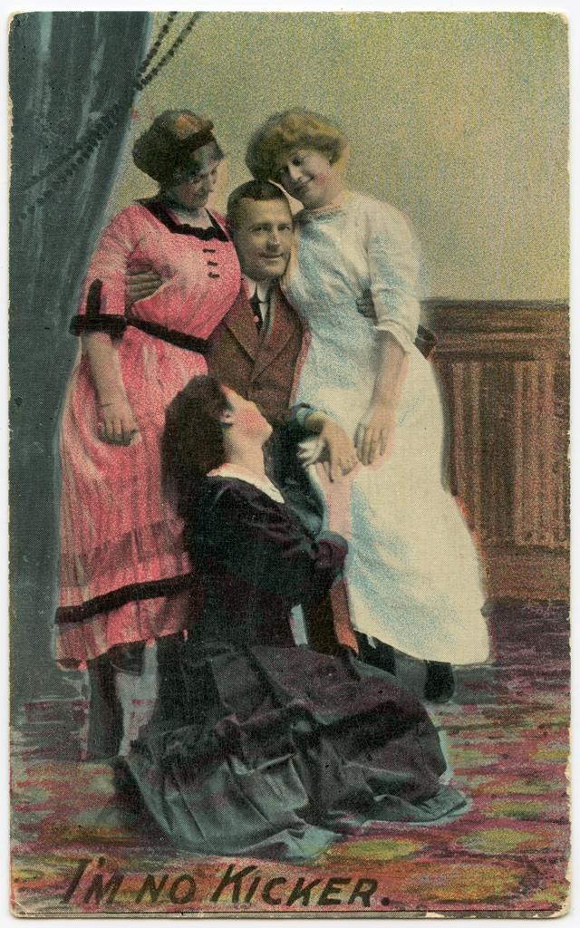
Sample Postcard
Notes:
Postcards were a way for friends and family to communicate. Businesses also would send postcards telling about a sale they were having. There was no TV, no internet, phones existed but not many people had them. The postcard was the cheapest way to communicate with each other. Think of the postcard as today’s version of a text message. There were no cell phones or text messaging either.

Slide 13
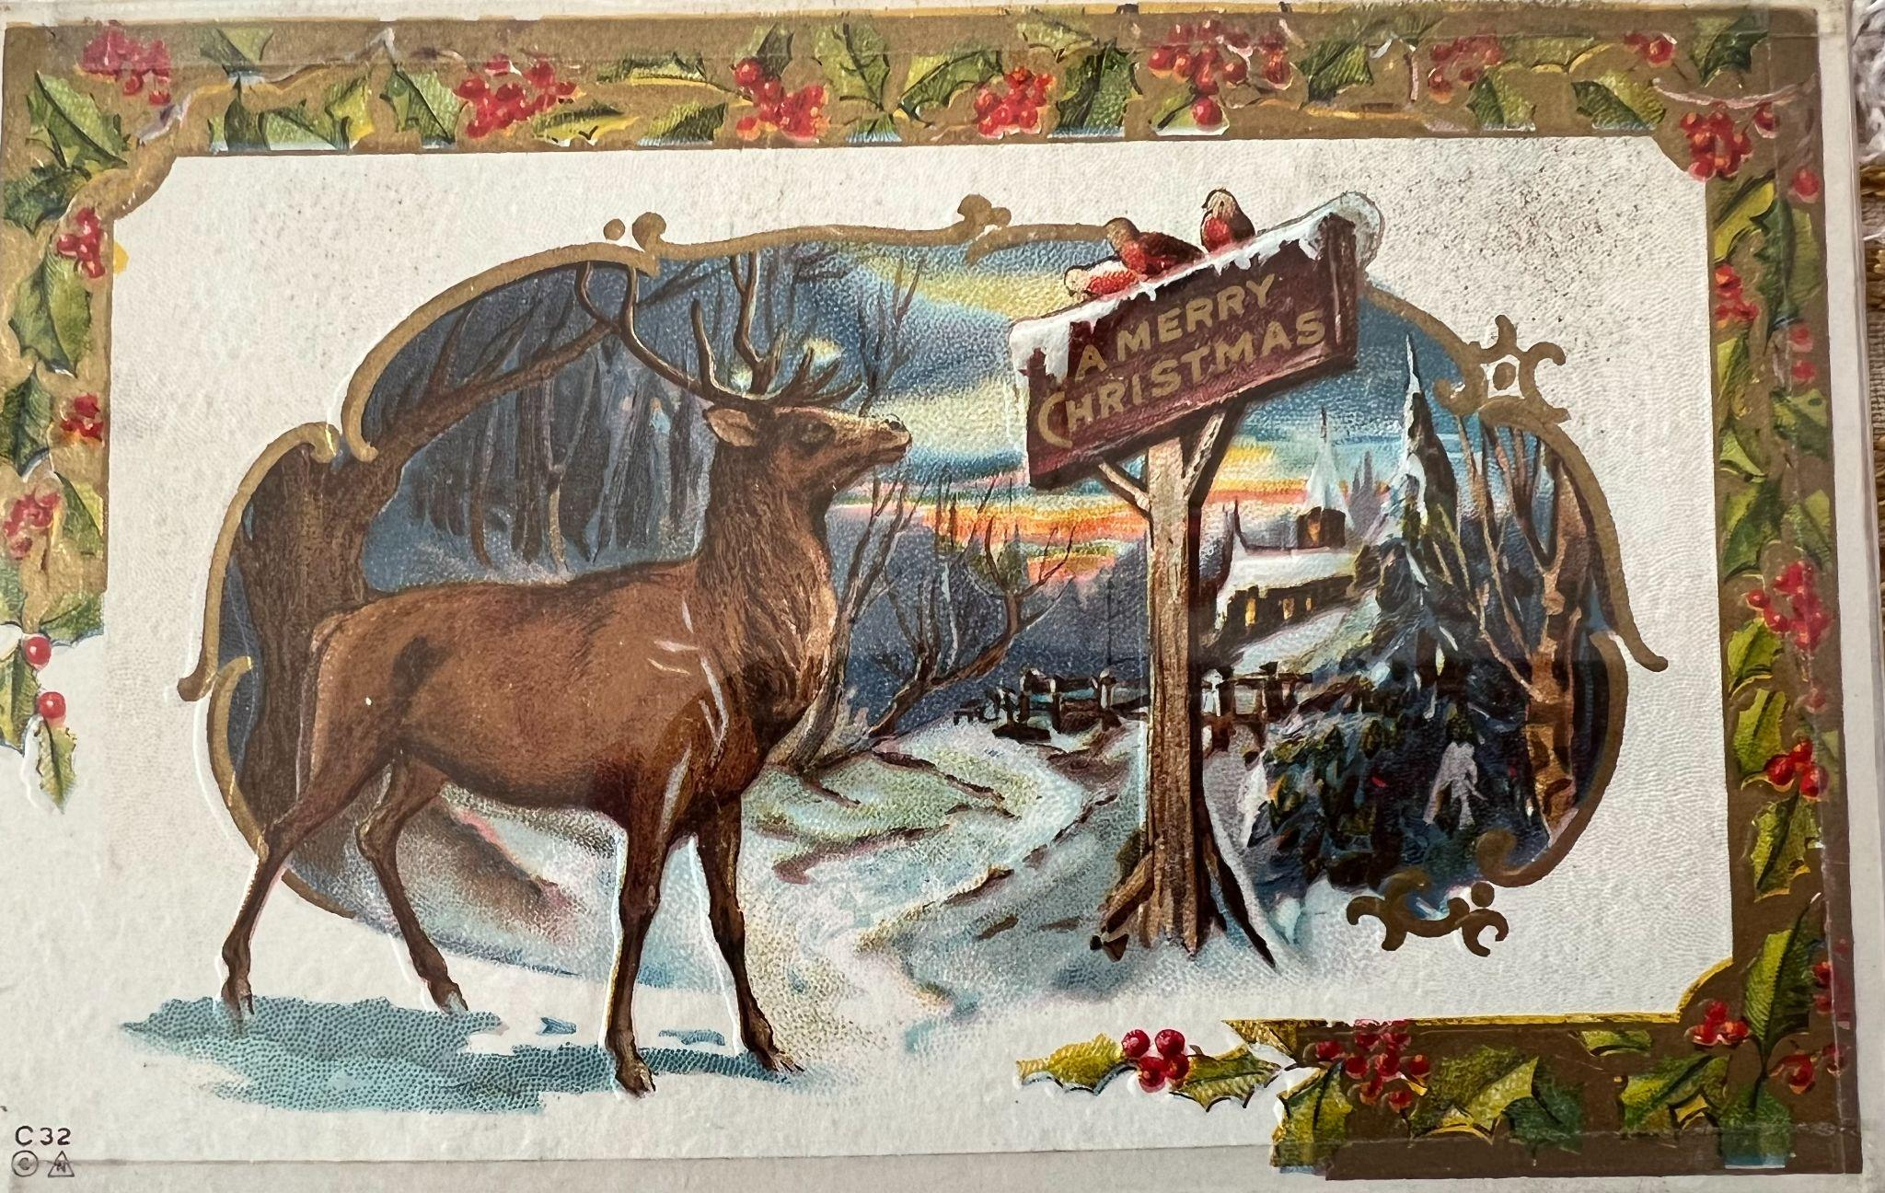
Sample Postcard
Notes:
Holiday cheer postcard from the early 1900s

Slide 14
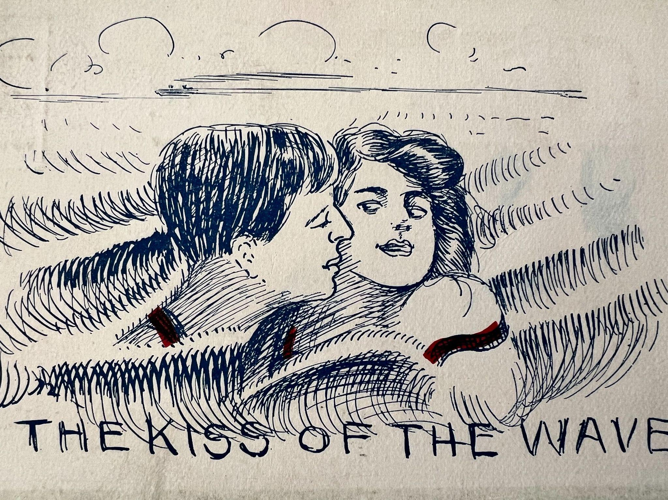
Sample Postcard
Notes:
Sweethearts used to send postcards to each other to keep them informed of how much they liked them. Postcards like a telegraph message had to be short and sweet. No a lot of words fit on the back of a postcard. If you were writing something to someone you liked and you knew that everyone who handled the postcard would be able to read it, what would you say to let them know that you liked them?

Slide 15
Sample Postcard
Notes:
This is a more modern postcard that is sold at the Pioneer Museum in Flagstaff, Arizona. It show the beauty of the Sedona area with Cathedral Rock. Arizona has many different elevations and offers people the desert, mountain regions, high country elevations. But no ocean!

Slide 16
Sample Postcard
Notes:
The is one of the Arizona Historical Society museums that you can come visit. Your school can do a tour, your family can stop by if you are in the area or on vacation. Come see us and learn more about Arizona Pioneer History!

Slide 17
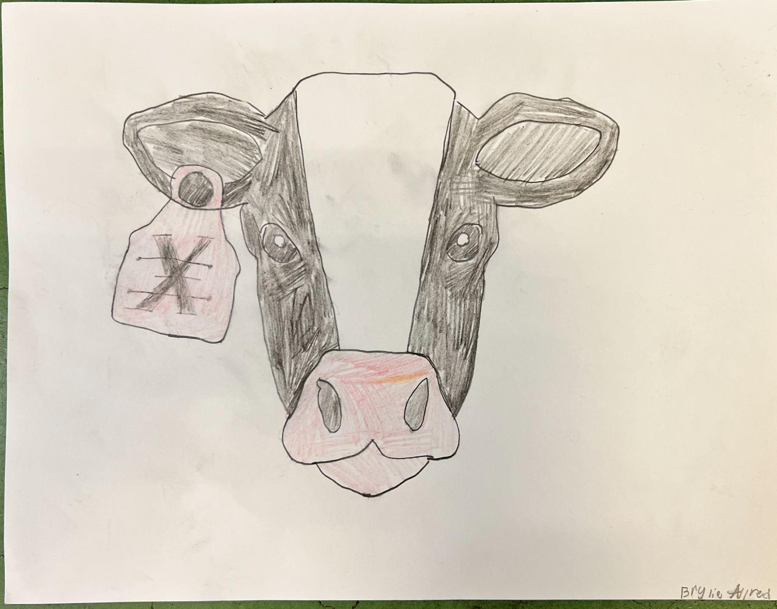
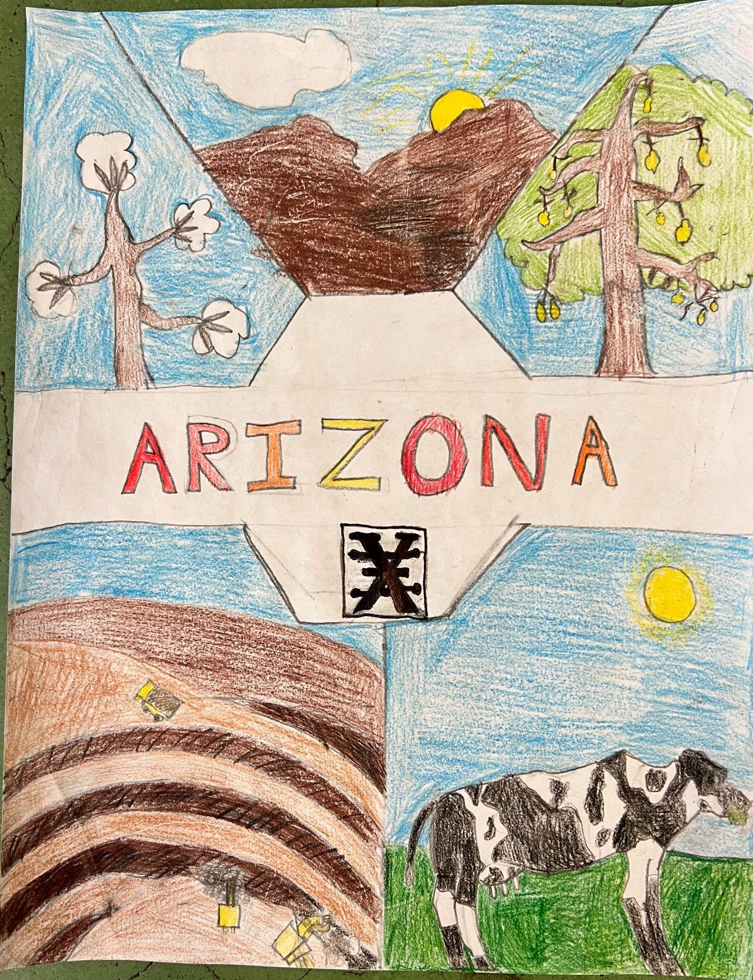
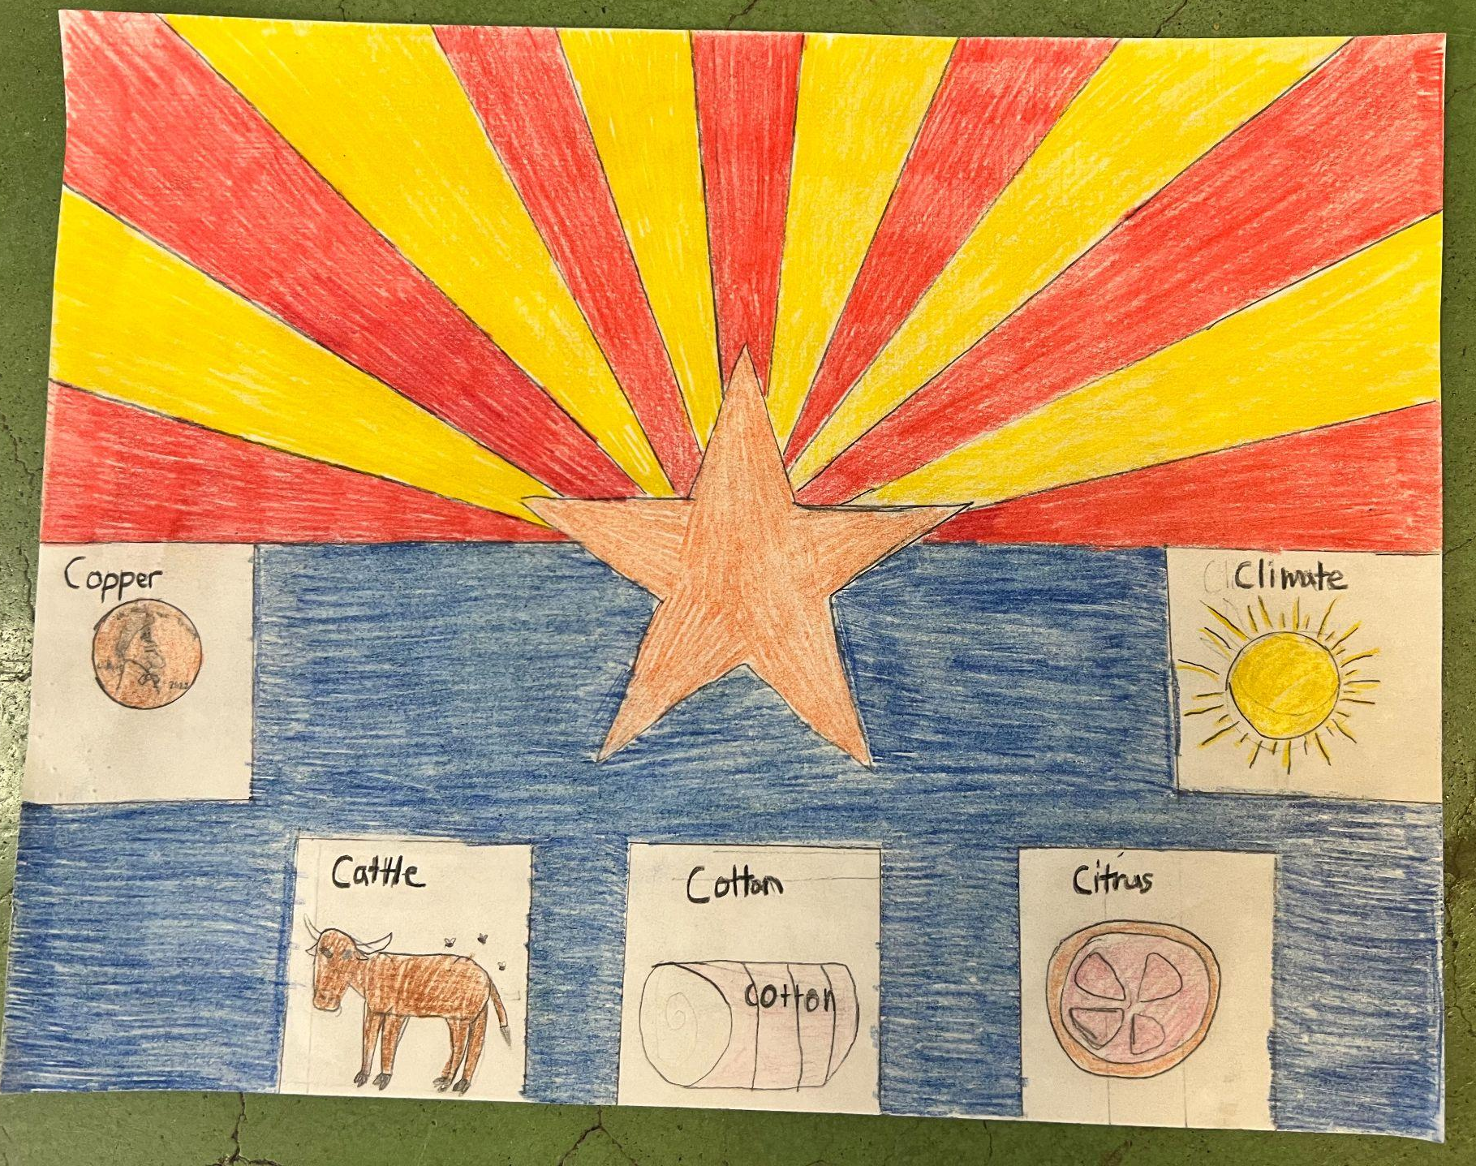
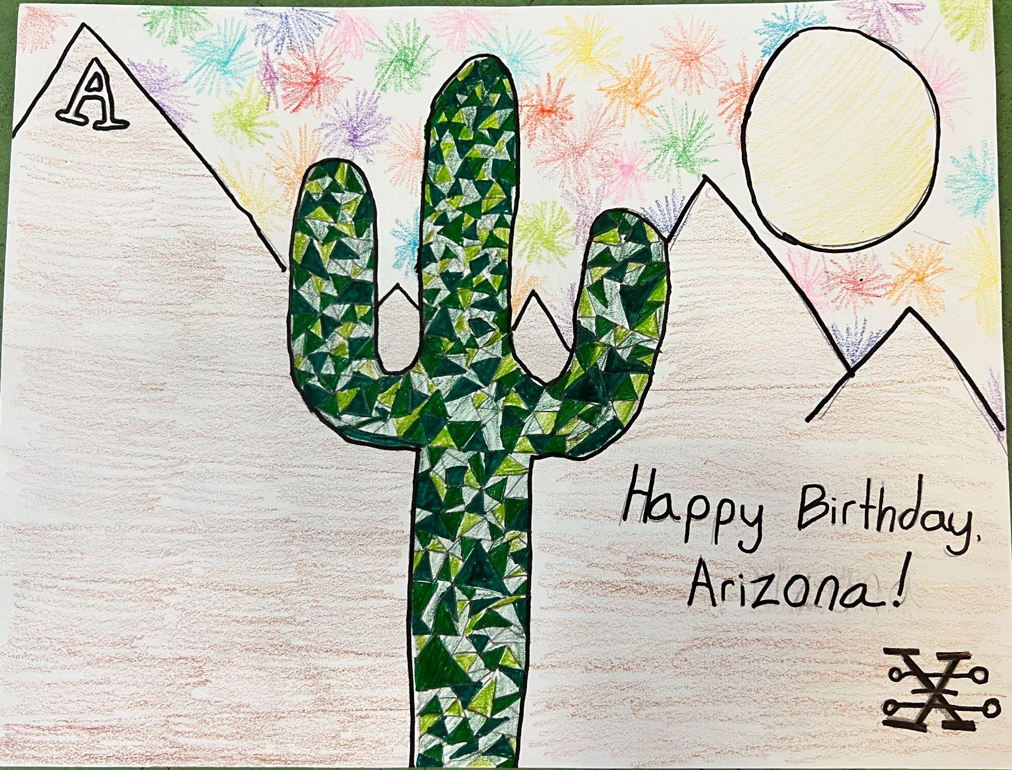
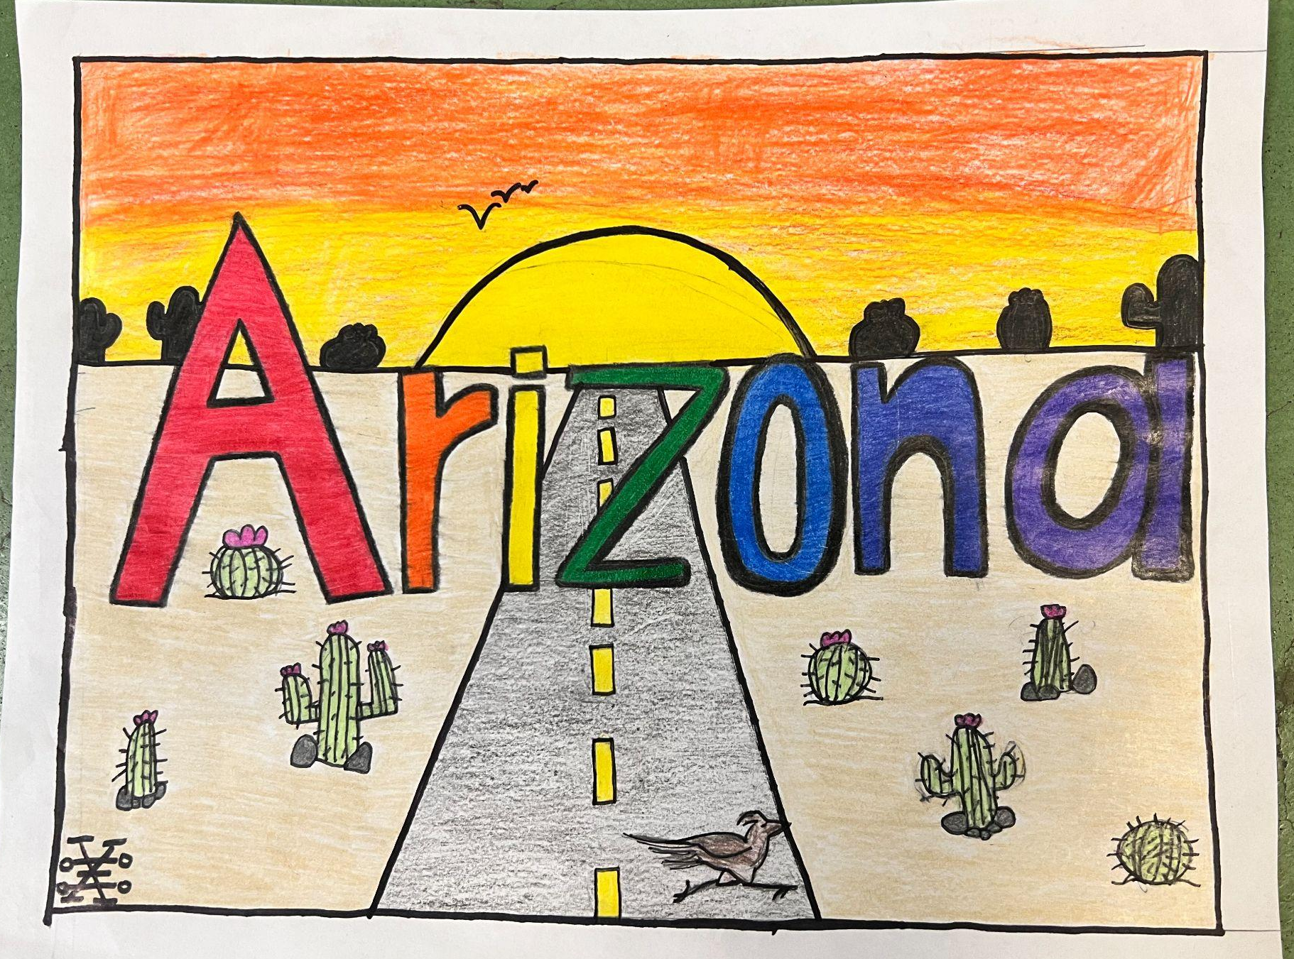
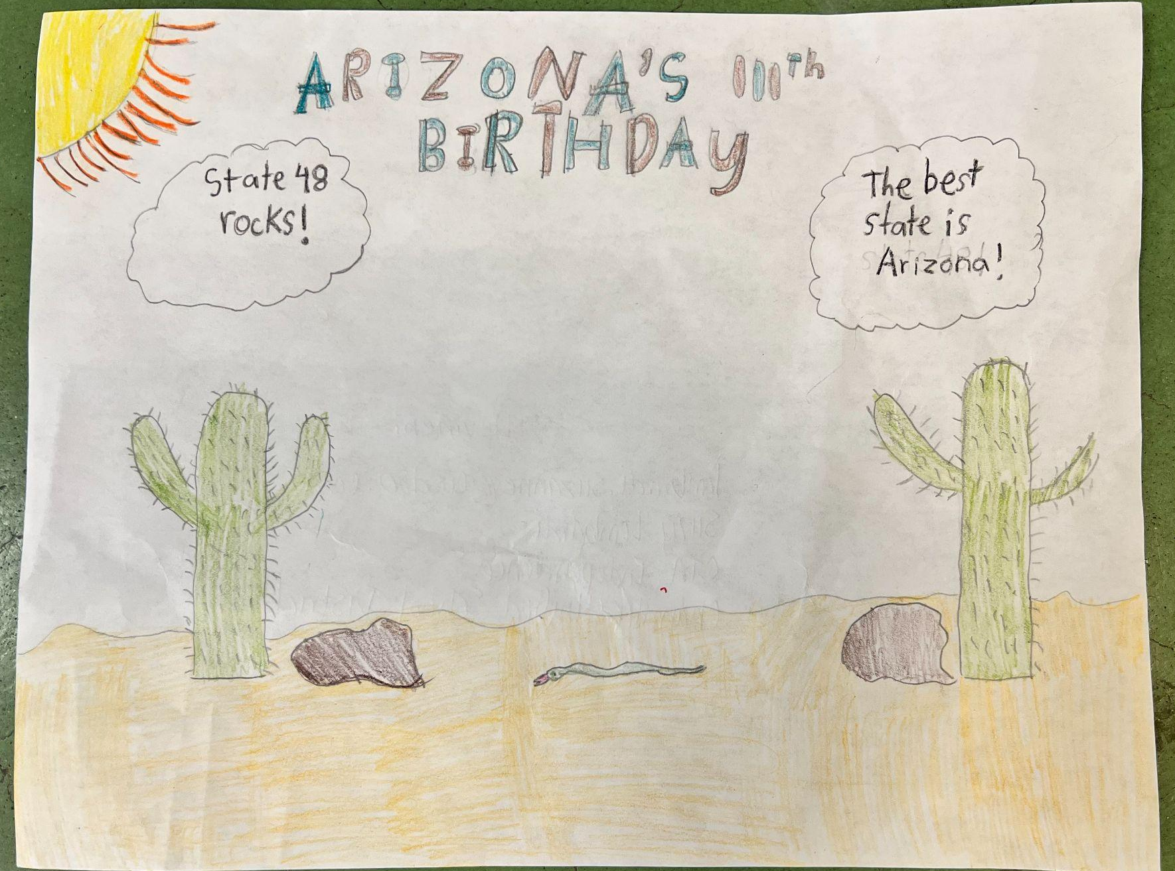
2023 Postcard Winners
Notes:
These are the six winners postcards from the 2023 AHS Postcard Contest.

Slide 18
Resources and Support for this project:
The postcards used for this presentation are Postcards which represent Arizona subjects or were posted from Arizona post offices up until the year 1920. Also included were two modern postcards that can be purchased at one of our museums. They are a visual demonstration of how Arizona has changed since the territorial period and many of the cards show towns, buildings, and ways of life which no longer exist. Messages on the reverse of these postcards comment on the experiences of inhabitants and visitors, and as a whole, this collection demonstrates how the postal service provided a vital means of communication for those wanting to stay in touch with people "back home."
Resources:
https://azmemory.azlibrary.gov/nodes/view/45030.
Also many of the activities for this contest offered to help build a better understanding of Arizona to help has been made available to you by
The Postal History Foundation
Arizona Real Photo Postcards A History & Portfolio, Jeremy Row Carl Mautz Publishing Nevada City, California 2006.

Slide 19
Contest Rules
(See complete list of rules on our website)
arizonahistoricalsociety.org
Your postcard should be created by you. No photos or graphics. Student artwork only.
Create your postcard on an 8 ½” X 11” piece of white copier paper.
Your teacher may send 1 entry per class.
All submissions must be postmarked by February 2, 2024.
If you can incorporate the Arizona Historical Society logo in your artwork, and it is selected, you will receive a BONUS prize.
Notes:
More information about the contest rules can be found on our website in the Education section, then click Arizona History Digital Hub, and then Teacher Resources.

