Slide 1
National History Day
in AZ
2023 - 2024
Understanding
the Theme:
Turning Points in History
Jenny Pennington
Coordinator-NHDAZ
Kristen Rex
Coordinator-NHDAZ
Notes:
Hi there! Thank you so much for joining me today as we host our very first workshop of the 2024 season! This is recorded and will be uploaded and shared through social media and our website, so be sure to check out National History Day in Arizona for the most up to date updates and info.
My name is Jenny Pennington, I am one of the co-coordinators of NHD along with Dr. Rex. We’re so excited to be back for the 2024 season. Today, we’re going to focus on Understand the Theme – Turning Points in History as well as maybe spark some inspiration for project ideas along the way.

Slide 2
What is the annual theme?
Students pick a topic that relates to the theme and ensures that they can defend that this project represents the theme and why.
The annual theme is intentionally broad to give students a lot of freedom in the direction they take their project.
What’s is a “turning point”?
What comes to mind when you think about “turning points”?
Turning Point: “A time which a decisive change in a situation occurs, especially one with beneficial results.” “A point where an important change occurs”
“Critical moment” “Crossroads” “Moment of Truth”
Notes:
The theme is very important in NHD. You need to be sure to include in your project why your project is related to the NHD theme. How is this topic a turning point? It’s pretty broad, so think of things you enjoy, math, science, music, art, whatever! There are some many topics from so many backgorunds and fields that you can use to fit this theme.
So what is a turning point? What do you think of when you think turning point? Being a lover of military history, my mind immediately goes to battles. We always talk about “turning points” in war – when the script is totally flipped! Like the Battle of Saratoga. Everyone thought US was gonna lose up until that point! Same can be applied to other topics. What are some major turning points in areas that interest you?

Slide 3
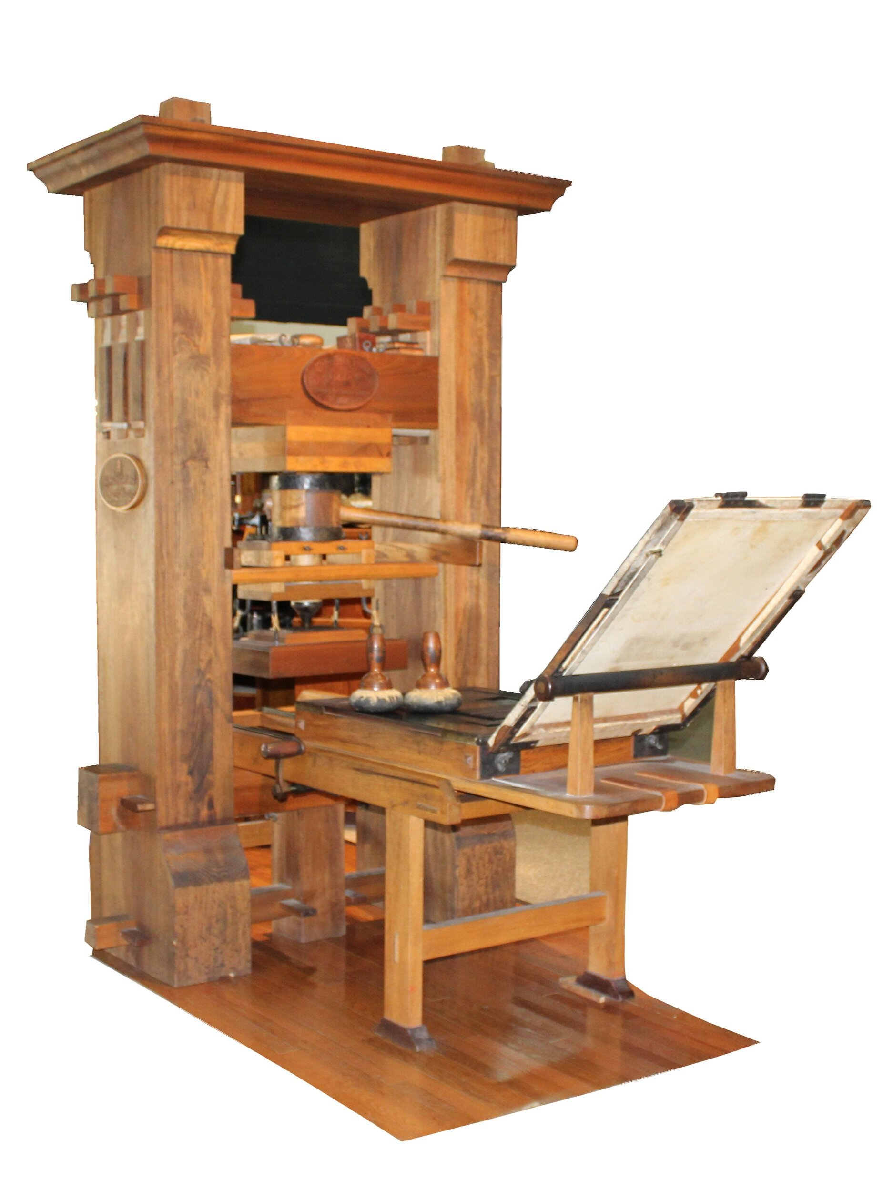
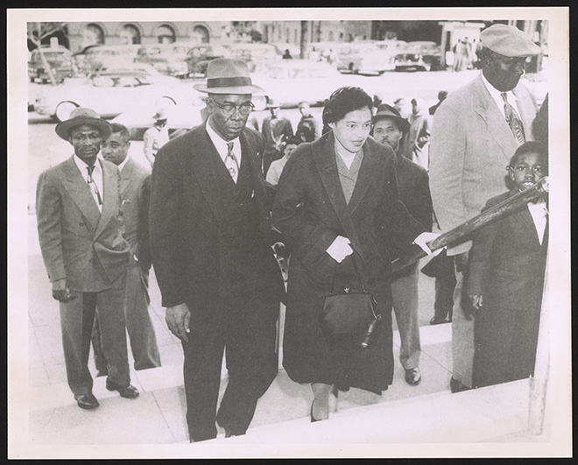
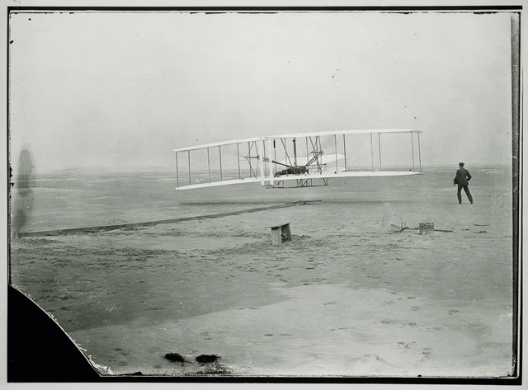
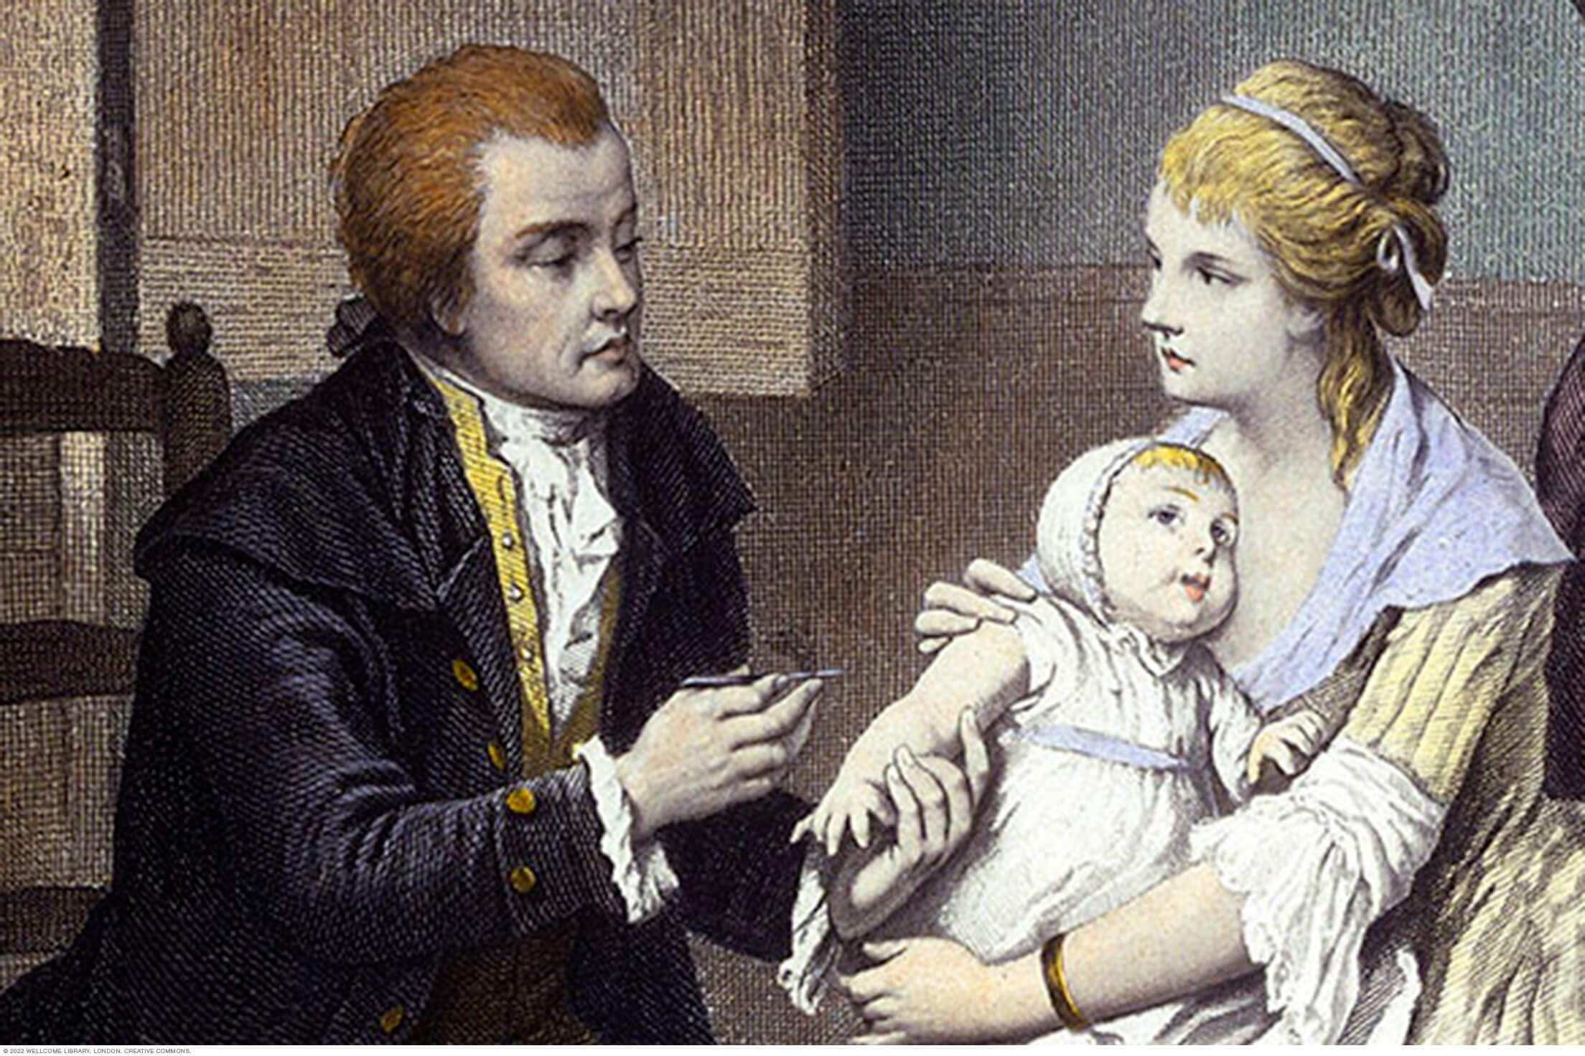
Gutenberg’s Printing Press
Montgomery Bus Boycott
The Wright Brothers
Smallpox Vaccine
Notes:
So here’s some ideas I was thinking. Now, please note these are broad topics. You need to come up with a thesis that you can argue.

Slide 4
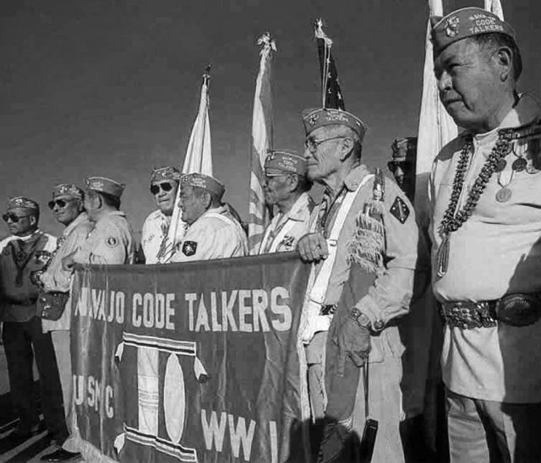
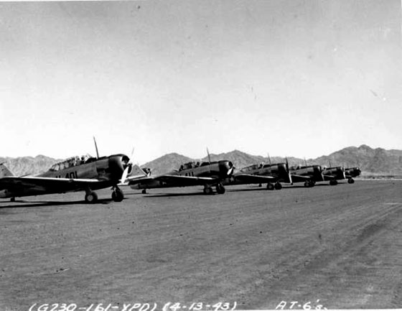
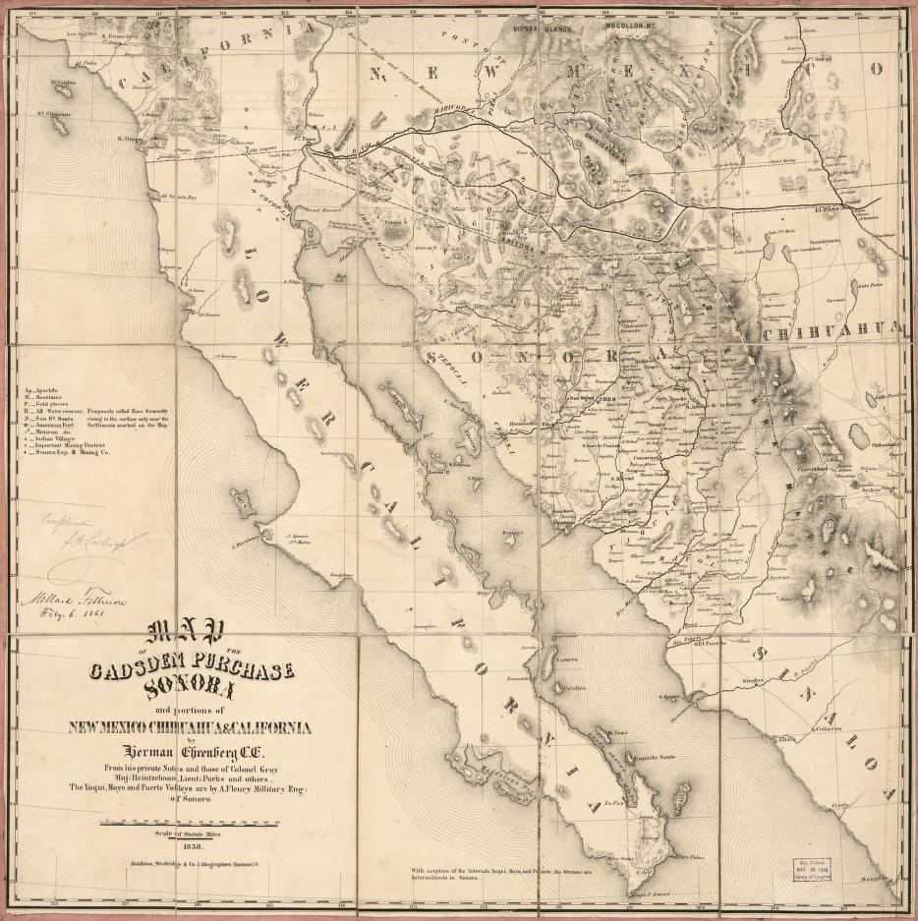
Raul Hector Castro – AZ’s 1st Hispanic governor
Navajo Code Talkers
WWII in AZ
Gadsden Purchase
Notes:
Of course, we had to throw in some AZ topics! We have a lot of great resources at the Arizona Historical Society that could help.

Slide 5
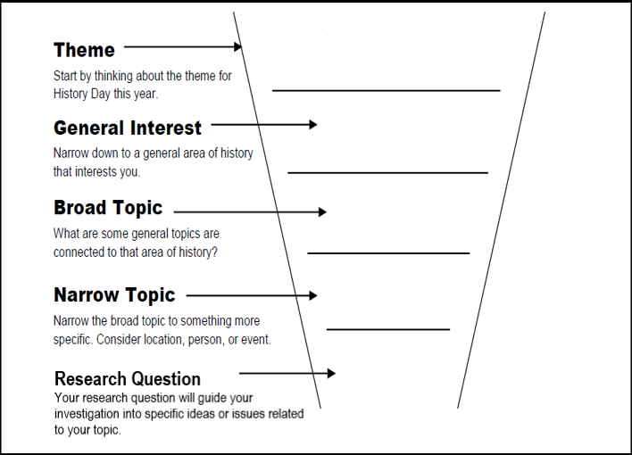
Notes:
So you got the theme, and an interest. Where do you go now? Use the funnel! Break it down step by step to really find a research questions and thesis you are happy with. I will walk through one with you!

Slide 6
THEME: Turning Points in History
GENERAL INTREST: Labor History
BROAD TOPIC: Women’s Rights
NARROW TOPIC: Triangle Shirtwaist Factory Fire
RESEARCH QUESTION: How did the events of the factory fire influence labor rights and legislation? What occurred because of it?
THESIS: The Triangle Shirtwaist Factory Fire was a catalyst that sparked a significant influx in awareness of the deplorable conditions of the female labor force. The results of this tragedy led to the passage of 30 separate laws about workplace reform and workers' rights, including regulating the minimum wage and working conditions.
Notes:
Please note: You cannot use my thesis for your project, be creative and think of things that interest you the most!

Slide 7
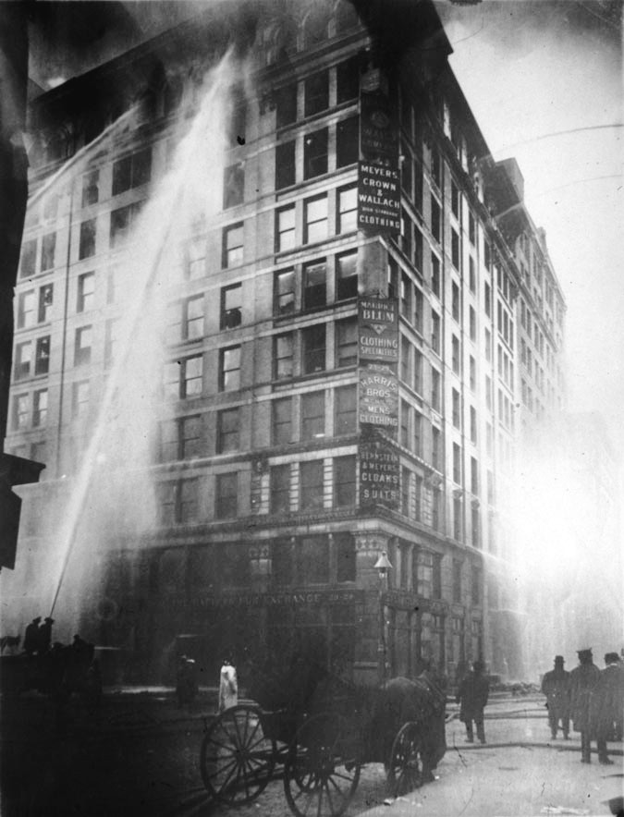
Considerations for topic: Triangle Shirtwaist Factory Fire
Historical Context > What is the time frame? How does that context play into the event?
1911 - what was happening?
No labor laws
Immigration
Consequences?
Multiple Perspectives > What are the different veiwpoints?
Workers and their families
Buisness owners
Witnesses of the event
Politicians?
Make the case: How is your topic a turning point? What was happening before and after that makes your topic a significant moment in history? Thank about what changed.
Notes:
So what are some things I should look at when trying to research? These are categories that are on the rubric for all projects and are incredibly important! If you are struggling with these you are more than welcome to ask for office hours with us or your teacher!

Slide 8
Remember!
Pick something that you’re passionate about!
Match the theme –
How is this a turning point?
Historical Significance –
Why is your topic important?
Context
Multiple Perspectives
Don’t be afraid to ask for help! - nhdaz@azhs.gov

Slide 9
Thank you and good luck!!!
Some helpful links:
NHDAZ Website
NHDAZ YouTube
NHD Website
Library of Congress
Office Hours Sign-Up
Contact us!
NHDAZ@AZHS.GOV
928-782-1841
Notes:
We will be posting this ppt on our website and you can also request a copy! You can contact me Tuesday – Saturday at 928-782-1841 or email me at nhdaz@azhs.gov. I will try to get back to you within 24-48hrs. Please be sure to join us for our first LIVE workshop on October 13th at 4pm – We’ll be going over how to find things on our website as well as resources we have that can help with NHD! Look forward to seeing you there and I hope you have a great rest of your day!

